Slide 1
pulse
MAY 2022

Slide 2
3 May - World Asthma Day
Fruits and vegetables that reduce asthma symptoms
Asthma is a respiratory condition where the airways become narrow and swell up, which makes breathing difficult. Caused by reasons ranging from environmental to genetic factors, asthma triggers coughing, shortness of breath and difficulty in breathing. Medical treatments of asthma include using inhalers. However, there are a range of fruits and vegetables that can help in reducing asthma symptoms as well.
Below are a list of fruits and vegetables that should be consumed to reduce symptoms of asthma.
Bell Peppers/Beta-Carotene: High in vitamin C, bell peppers, bell peppers have high antioxidant and phytonutrient levels which contribute to good health.
Pomegranates: Loaded with fiber, vitamin C, and vitamin K and antioxidants, pomegranates help in preventing or delaying cell damage.
Apples: They are rich in fiber and antioxidants. They help in losing weight and bosting gut health. Apples also help in preventing chronic illnesses such as diabetes, heart disease, and cancer.
Green Beans: Green beans are loaded with vitamins A, C, and K, and of folic acid, calcium and fiber. They are important for maintaining strong, healthy bones and reducing the risk of fractures. Vitamin B present in green beans also help in reducing depression.
Ginger: Rich in antioxidants, it helps in preventing stress and damaging the body’s DNA. It also helps in fighting chronic conditions such as high blood pressure, heart disease, and diseases of the lungs. It helps in promoting healthy aging.
Spinach: This superfood contains protein, iron, vitamins, minerals, potassium, magnesium, vitamin K, fiber, phosphorus, thiamine and vitamin E. It is important for skin, hair, and bone health. It also helps in reducing asthma symptoms.
Tomato juice: It is loaded with vitamin C, B vitamins, and potassium. Being a rich source of antioxidants, such as lycopene, it helps in reducing risk of heart diseases and some types of cancer.
Orange: Loaded with vitamins, minerals, and antioxidants, they are a treasure trove of nutrients. It is also rich in Vitamin C and folate.
Avocado: Avocados are rich in healthy fats and fiber, magnesium, B6, vitamin C, vitamin E, folate. They help in preventing respiratory diseases.

Slide 3
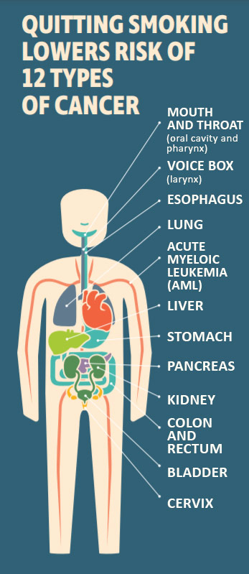
Cardiovascular Health Benefits of Quitting Smoking
Quitting smoking is one of the most important actions people who smoke can take to reduce their risk for cardiovascular disease.
reduces the risk of disease and death from cardiovascular disease.
reduces markers of inflammation and hypercoagulability.
leads to rapid improvement in high-density lipoprotein cholesterol (HDL-C) levels.
reduces the development of subclinical atherosclerosis and slows its progression over time.
reduces the risk of coronary heart disease with risk falling sharply 1-2 years after cessation and then declining more slowly over the longer term.
reduces the risk of disease and death from stroke with risk approaching that of never smokers after cessation.
reduces the risk of abdominal aortic aneurysm, with risk reduction increasing with time since cessation.
may reduce the risk of atrial fibrillation, sudden cardiac death, heart failure, venous thromboembolism, and peripheral arterial disease (PAD).

Slide 4
MAY 8 - OVARIAN CANCER AWARENESS DAY
Ovarian cancer is a type of cancer that begins in a woman’s ovaries – the small organs in the female reproductive system that create eggs. This kind of cancer can be difficult to detect because it often doesn’t cause any symptoms until later stages. Once found, ovarian cancer can be treated with chemotherapy and surgery to remove any tumors.
What are the symptoms of ovarian cancer?
Unfortunately, ovarian cancer can develop, become quite large and spread throughout the abdomen before it causes any symptoms. This can make early detection difficult. When you experience symptoms, they can include:
Having pain, discomfort or bloating in your abdomen and pelvis.
Experiencing changes in your eating habits, getting full early and losing your appetite. You may experience bloating and belching, sometimes even stomach pain.
Having abnormal bleeding or vaginal discharge (especially if the bleeding is happening outside of your typical menstrual cycle or after you have gone through menopause) and, more often, changes in your bowels, such as diarrhea and constipation.
Feeling any unusual lumps or finding increase in the size of your abdomen.
Having urinary frequency or urinary urgency.
How is ovarian cancer diagnosed?
Pap smears, mammograms and colonoscopy are examples of screening tests that many people are familiar with. Unfortunately, there are no screening tests for ovarian cancer. Testing typically happens after you have symptoms. Because the symptoms of ovarian cancer are varied, persistent symptoms lasting more than two to three weeks are important to discuss with your doctor. Additional tests could include:
Pelvic ultrasound: An ultrasound is an imaging test that uses sound waves to create a picture of your internal organs. This can be done on top of your skin (typically your abdomen) or internally, with a wand. An internal ultrasound is called a transvaginal ultrasound. These imaging tests are painless and include no preparation on your part. This test is typically followed by several more tests that will confirm your diagnosis. Other imaging tests that can help diagnose ovarian cancer can include:
MRI (magnetic resonance imaging).
CT scan (computed tomography).
PET scan (positron emission tomography).
Chest X-ray.
Blood tests
Surgical evaluation
Laparoscopy

Slide 5
Chronic fatigue syndrome
Chronic fatigue syndrome (CFS) is a complicated disorder characterized by extreme fatigue that lasts for at least six months and that can't be fully explained by an underlying medical condition. The fatigue worsens with physical or mental activity, but doesn't improve with rest.
This condition is also known as myalgic encephalomyelitis (ME). Sometimes it's abbreviated as ME/CFS. The most recent term proposed is systemic exertional intolerance disease (SEID).
The cause of chronic fatigue syndrome is unknown, although there are many theories — ranging from viral infections to psychological stress. Some experts believe chronic fatigue syndrome might be triggered by a combination of factors.
There's no single test to confirm a diagnosis of chronic fatigue syndrome. You may need a variety of medical tests to rule out other health problems that have similar symptoms. Treatment for chronic fatigue syndrome focuses on improving symptoms.
Symptoms
Symptoms of chronic fatigue syndrome can vary from person to person, and the severity of symptoms can fluctuate from day to day. Signs and symptoms may include:
Fatigue
Problems with memory or concentration
Sore throat
Headaches
Enlarged lymph nodes in your neck or armpits
Unexplained muscle or joint pain
Dizziness that worsens with moving from lying down or sitting to standing
Unrefreshing sleep
Extreme exhaustion after physical or mental exercise
When to see a doctor
Fatigue can be a symptom of many illnesses, such as infections or psychological disorders. In general, see your doctor if you have persistent or excessive fatigue.
Causes
The cause of chronic fatigue syndrome is still unknown. Some people may be born with a predisposition for the disorder, which is then triggered by a combination of factors. Potential triggers include:
Viral infections. Because some people develop chronic fatigue syndrome after having a viral infection, researchers question whether some viruses might trigger the disorder. Suspicious viruses include the Epstein-Barr virus, human herpes virus 6. No conclusive link has yet been found.
Immune system problems. The immune systems of people who have chronic fatigue syndrome appear to be impaired slightly, but it's unclear if this impairment is enough to actually cause the disorder.
Hormonal imbalances. People who have chronic fatigue syndrome also sometimes experience abnormal blood levels of hormones produced in the hypothalamus, pituitary glands or adrenal glands. But the significance of these abnormalities is still unknown.
Physical or emotional trauma. Some people report that they experienced an injury, surgery or significant emotional stress shortly before their symptoms began.

Slide 6
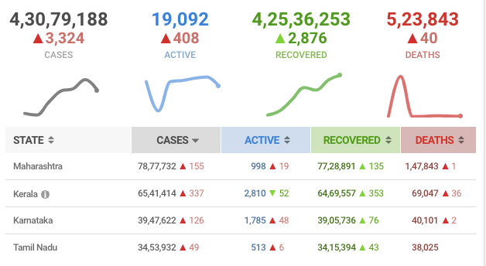
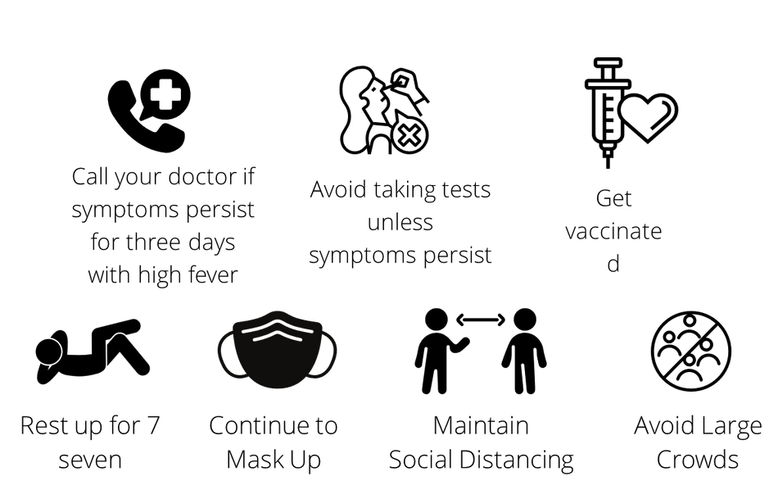
Covid Update
MAIL YOUR FEEDBACKS AND SUGGESTIONS TO: HOLA@FUTURISK.IN

